Slide 1
Attacks, Concept and Techniques
Module 2

Slide 2

Social Enginering
Social engineering is the tactic of manipulating, influencing, or deceiving a victim in order to gain control over a computer system, or to steal personal and financial information. It uses psychological manipulation to trick users into making security mistakes or giving away sensitive information.
Social engineering attacks happen in one or more steps. A perpetrator first investigates the intended victim to gather necessary background information, such as potential points of entry and weak security protocols, needed to proceed with the attack. Then, the attacker uses a form of pretexting such as impersonation to gain the victim’s trust and provide stimuli for subsequent actions that break security practices, such as revealing sensitive information or granting access to critical resources.

Slide 3
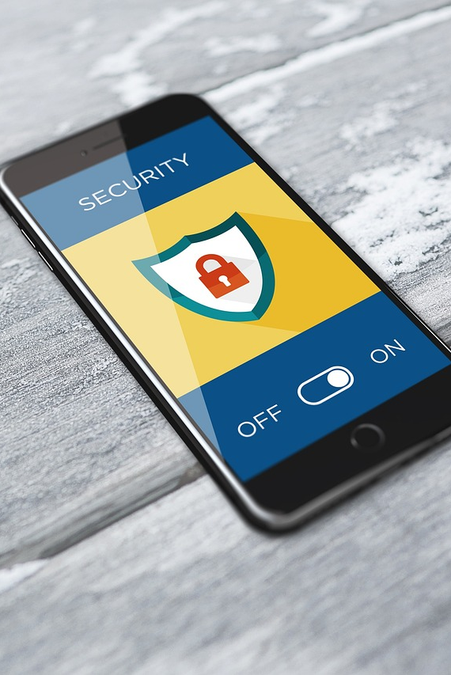
Types of Social Engineering Attacks
Social engineering attacks come in many different forms and can be performed anywhere where human interaction is involved. The following are common forms of digital social engineering attacks.

Slide 4
Types of social Enginering Attacks
Phishing
The process of attempting to acquire sensitive information such as usernames, passwords, and credit card details by masquerading as a trustworthy entity using bulk email, SMS text messaging, or by phone. Phishing messages create a sense of urgency, curiosity, or fear in the recipients of the message. The message will prod victims into revealing sensitive information, clicking on links to malicious websites, or opening attachments that contain malware
Baiting
A type of social engineering attack where a scammer uses a false promise to lure a victim into a trap which may steal personal and financial information or inflict the system with malware. The trap could be in the form of a malicious attachment with an enticing name.
The most common form of baiting uses physical media to disperse malware. For example, attackers leave the bait of a malware-infected flash drives in conspicuous areas where potential victims are certain to see them. When the victim inserts the flash drive into a work or home computer, the malware is automatically installed on the system. Baiting scams are also online in the form of tempting ads that lead to malicious sites or encourage users to download a malware-infected application.

Slide 5
Phishing
The process of attempting to acquire sensitive information such as usernames, passwords, and credit card details by masquerading as a trustworthy entity using bulk email, SMS text messaging, or by phone. Phishing messages create a sense of urgency, curiosity, or fear in the recipients of the message. The message will prod victims into revealing sensitive information, clicking on links to malicious websites, or opening attachments that contain malware
Tailgating
Also known as "piggybacking". A physical breach where an unauthorized person manipulates their way into a restricted or employee only authorized area through the use of social engineering tactics. The attacker might impersonate a delivery driver, or custodian worker. Once the employee opens the door, the attacker asks the employee to hold the door, thereby gaining access to the building.
Scareware
Scareware involves victims being bombarded with false alarms and fictitious threats. Users are deceived to think their system is infected with malware, prompting them to install software that grants remote access for the criminal or to pay the criminal in a form of bitcoin in order to preserve sensitive video that the criminal claims to have.

Slide 6
Dumpster Diving
A scammer will search for sensitive information e.g., bank statements, pre-approved credit cards, student loans, other account information, in the garbage when it hasn’t been properly sanitized or destroyed.
Quid pro quo
Quid pro quo involves a criminal requesting the exchange of some type of sensitive information such as critical data, login credentials, or monetary value in exchange for a service. For example, a computer user might receive a phone call from the criminal who, posed as a technology expert, offers free IT assistance or technology improvements in exchange for login credentials. If an offer sounds too good to be true, it most likely a scam and not legitimate.
Shoulder surfing
This is as it sounds: watching the unsuspecting victim while they’re entering passwords and other sensitive information. But it doesn’t have to be at close range—literally looking over their shoulder. It could be from a distance—using binoculars or hidden cameras.
Spear phishing: a targeted, personalized attack aimed at a specific individual that appears to come from someone that individual trusts.
Whaling: A form of spear phishing aimed at high-profile, high-value targets like celebrities, public or private companies’ executives and board members, and government officials.

Slide 7
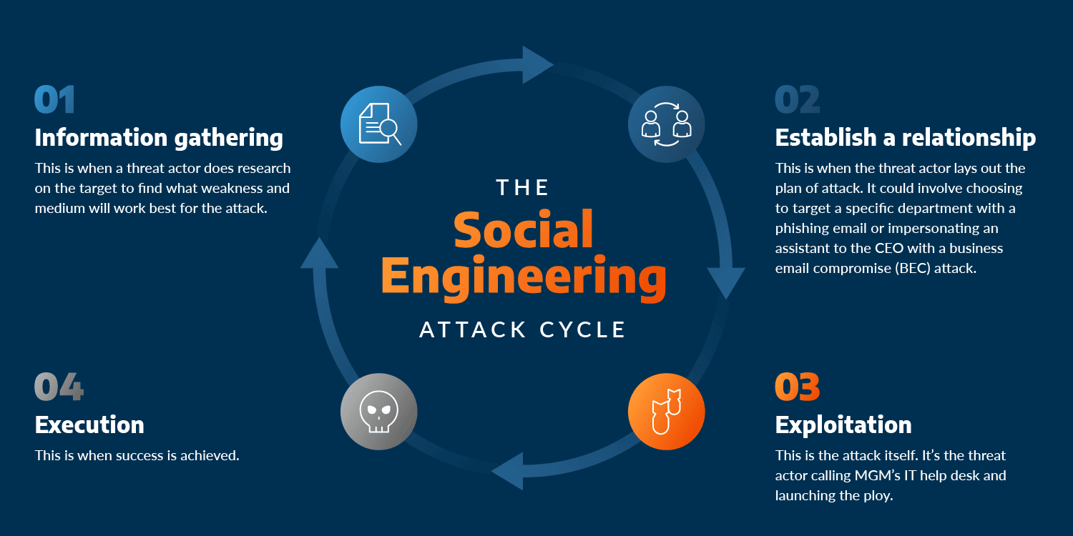

Slide 8
Social Engineering Prevention
Don't open email attachments from suspicious sources. Even if you do know the sender and the message seems suspicious, it's best to contact that person directly to confirm the authenticity of the message.
Be wary of tempting offers. If an offer seems too good to be true, it's probably because it is. Use a search engine to look up the topic which can help you quickly determine whether you're dealing with a legitimate offer or a trap.
Clean up your social media. Social engineers scour the Internet searching for any kind of information they can find on a person. The more information you have posted about yourself, the more likely it is that a criminal can send you a targeted spear phishing attack.
Install and update antivirus and other software. Make sure automatic updates are turned on. Periodically check to make sure that the updates have been applied and scan your system daily for possible infections.
Back up your data regularly. If you were to fall victim to a social engineering attack in which your entire hard drive was corrupted, it is essential that you have a backup on an external hard drive or saved in the cloud.
Avoid plugging an unknown USB into your computer. When a USB drive is found unattended, please give it to a cluster consultant, the Computer Services Help Center, a residence assistant (RA), or to Carnegie Mellon campus police.
Destroy sensitive documents regularly. All sensitive documents such as bank statements, student loan information, and other account information should be physically destroyed in a cross-shredder or placed in one of the blue or gray locked receptacles which are incinerated.

Slide 9

OSINT Investigation
Open-source intelligence (OSINT) enables investigators to use open-source software to gather and analyse data from open-data sources. Social media investigation is a branch of OSINT that entails gathering and analysing information from social media networking platforms, blogs, forums, photo/video sharing platforms etc.
Open source intelligence (OSINT) is the process of identifying, harvesting, processing, analyzing, and reporting data obtained from publicly available sources for intelligence purposes.
OSINT includes any offline or online information that is publicly available, whether free of cost, purchasable or obtainable by request.

Slide 10
How Attackers and Defenders Use OSINT
There are three common uses of OSINT: by cybercriminals, by cyber defenders, and by those seeking to monitor and shape public opinion
How Security Teams Use OSINT
For penetration testers and security teams, OSINT aims to reveal public information about internal assets and other information accessible outside the organization. Metadata accidentally published by your organization may contain sensitive information.
For example, useful information that can be revealed through OSINT includes open ports; unpatched software with known vulnerabilities; publicly available IT information such as device names, IP addresses and configurations; and other leaked information belonging to the organization.
Websites outside of your organization, especially social media, contain huge amounts of relevant information, especially information about employees. Vendors and partners may also be sharing specific details about an organization’s IT environment. When a company acquires other companies, their publicly available information becomes relevant as well.

Slide 11
How Threat Actors Use OSINT
A common use of OSINT by attackers is to retrieve personal and professional information about employees on social media. This can be used to craft spear-phishing campaigns, targeted at individuals who have privileged access to company resources.
LinkedIn is a great resource for this type of open source intelligence, because it reveals job titles and organizational structure. Other social networking sites are also highly valuable for attackers, because they disclose information such as dates of birth, names of family members and pets, all of which can be used in phishing and to guess passwords.
Another common tactic is to use cloud resources to scan public networks for unpatched assets, open ports, and misconfigured cloud datastores. If an attacker knows what they are looking for, they can also retrieve credentials and other leaked information from sites like GitHub. Developers who are not security conscious can embed passwords and encryption keys in their code, and attackers can identify these secrets through specialized searches.
Other Uses of OSINT
In addition to cybersecurity, OSINT is also frequently used by organizations or governments seeking to monitor and influence public opinion. OSINT can be used for marketing, political campaigns, and disaster management.
Note: Hackers often use OSINT techniques to gather information about potential targets. OSINT involves using publicly available information from social media, websites, and news articles to gather information about an individual or organization. This information can then be used to identify vulnerabilities and plan attacks.
Some useful OSINT Tools: https://github.com/jivoi/awesome-osint?tab=readme-ov-file

Slide 12
Analysing Cyber Attack
Cybercriminals use many different types of malicious software, or malware, to carry out their activities. Malware is any code that can be used to steal data, bypass access controls, or cause harm to or compromise a system. Knowing what the different types are and how they spread is key to containing and removing them.

Slide 13
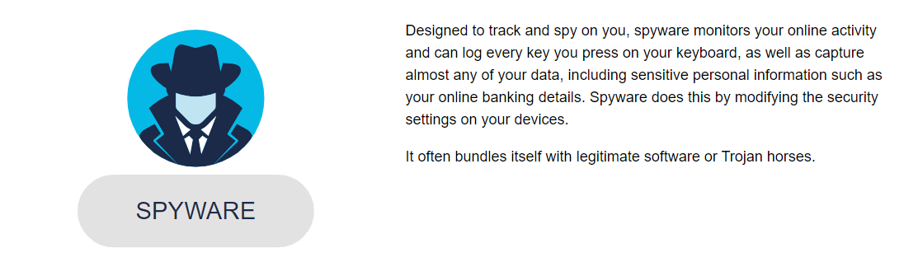
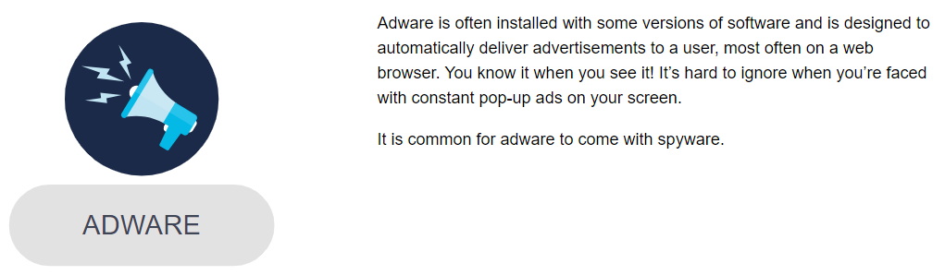
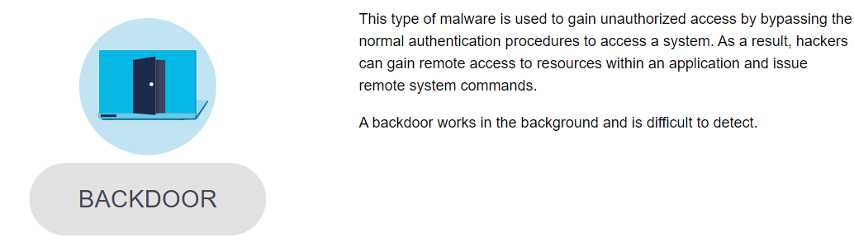
Types Of Malware

Slide 14
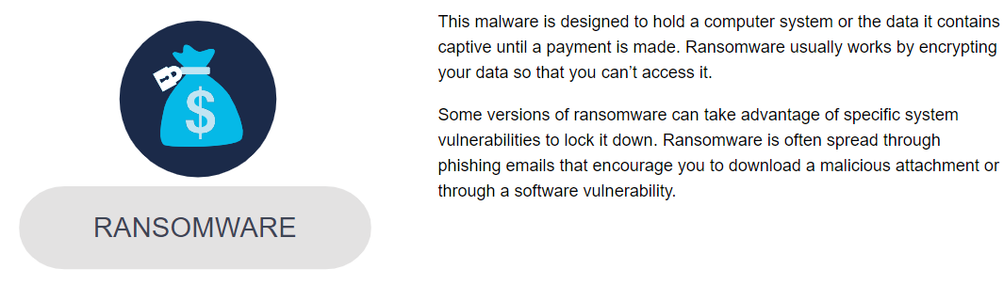
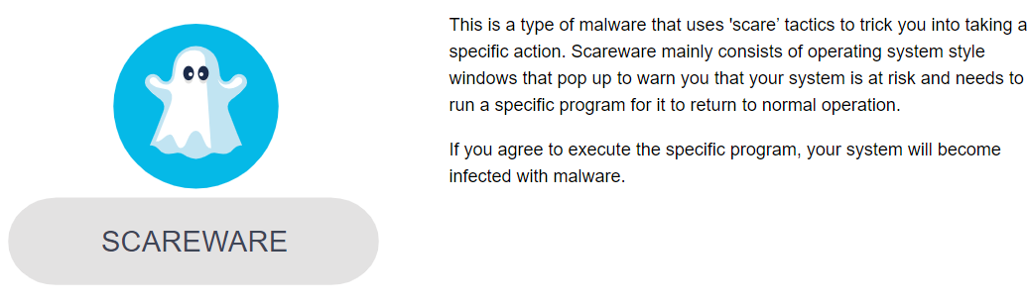
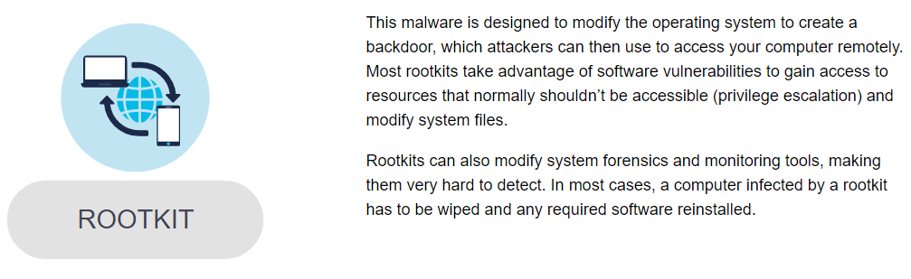

Slide 15
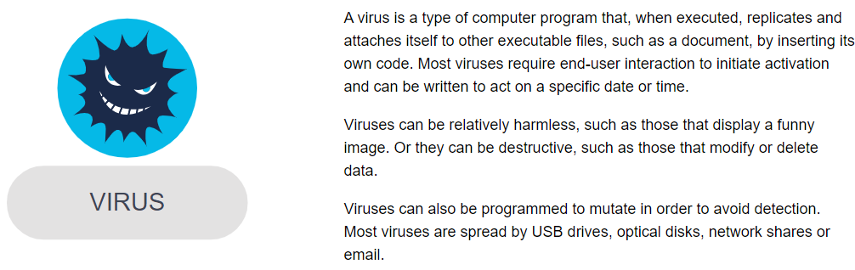
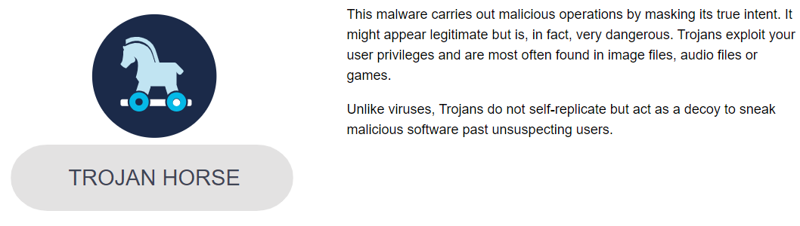
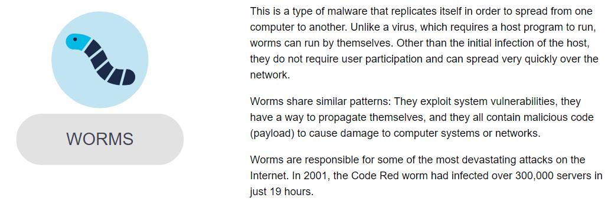

Slide 16

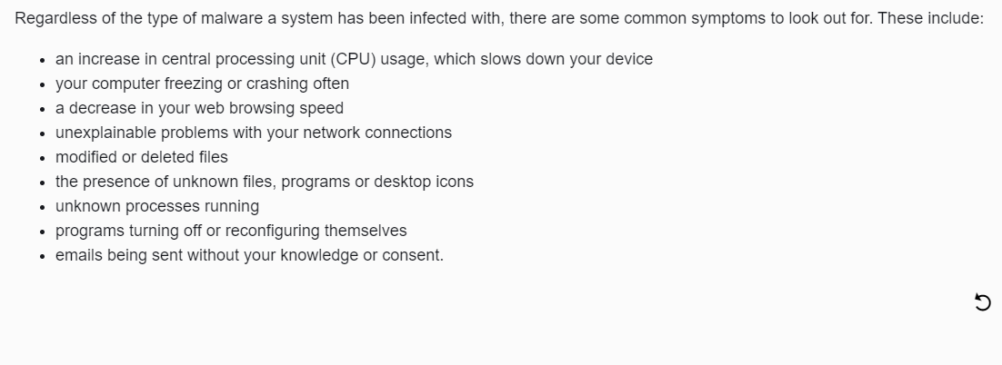
Symptoms of Malware

Slide 17
Quiz
Malware designed to track your online activity and capture your data (Spyware / Ransomware / Adware)
Software that automatically delivers advertisements (Ransomware / Worms / Adware)
Malicious code that attaches to legitimate programs and usually spreads by USB drives, optical media, network shares or email (Spyware / Adware / Virus)
Malicious code that replicates itself independently by exploiting vulnerabilities in networks (Worms / Virus / Adware)
Differentiate between social engineering and OSINT investigation

Slide 18
Thank you for your time 😊

Slide 19
Next Lesson 😊 > Methods of Infiltration > Security Vulnerability and Exploits

